Slide 1
INTERNSHIP PRESENTATION
UI/UX DESIGN
Anjali Kumari
25SCS1003004230
Codec Technologies Pvt. Ltd.
01/07/2026 – 01/08/2026

Slide 2
Internship Overview
Organization: Codec Technologies Pvt. Ltd.
Role: UI/UX Designer Intern
Duration: 01/07/2026 to 01/08/2026
Program: 1 Month AICTE & ICAC Approved Internship Program
Program Manager: Dr. Anurag Shrivastava

Slide 3
About UI/UX Design
UI (User Interface) focuses on visual and interactive interface elements.
UX (User Experience) focuses on the overall usability and effectiveness of a product.
Good design connects user needs with clear information, intuitive interaction, and visual consistency.

Slide 4
Internship Objectives
Understand user-centered design principles.
Learn the basic stages of a UI/UX design workflow.
Improve understanding of layout, hierarchy, spacing, and consistency.
Understand wireframes, user flows, and prototypes.
Develop awareness of usability and responsive design.

Slide 5
Core UI/UX Concepts
User Research — identify user needs and pain points.
Information Architecture — organize content and navigation.
Wireframing — plan the structure of screens.
Visual Design — create clear and consistent interfaces.
Prototyping — represent interactions before development.
Usability Testing — evaluate ease of use.

Slide 6
Typical Design Workflow
1. Define the problem and user goal
2. Understand requirements and user needs
3. Plan information architecture and user flow
4. Create wireframes
5. Develop visual design and prototype
6. Review, test, and refine
7. Prepare design for implementation

Slide 7
Learning Outcomes
User-centered thinking
Better visual hierarchy and interface organization
Understanding of wireframes, prototypes, and user flows
Awareness of usability, accessibility, and responsive design
Clearer communication of design decisions

Slide 8
Challenges & Improvements
Balancing simplicity with the amount of information users need.
Maintaining consistency across screens and interactions.
Making important user flows easy to understand.
Improving designs through review, testing, and iteration.

Slide 9
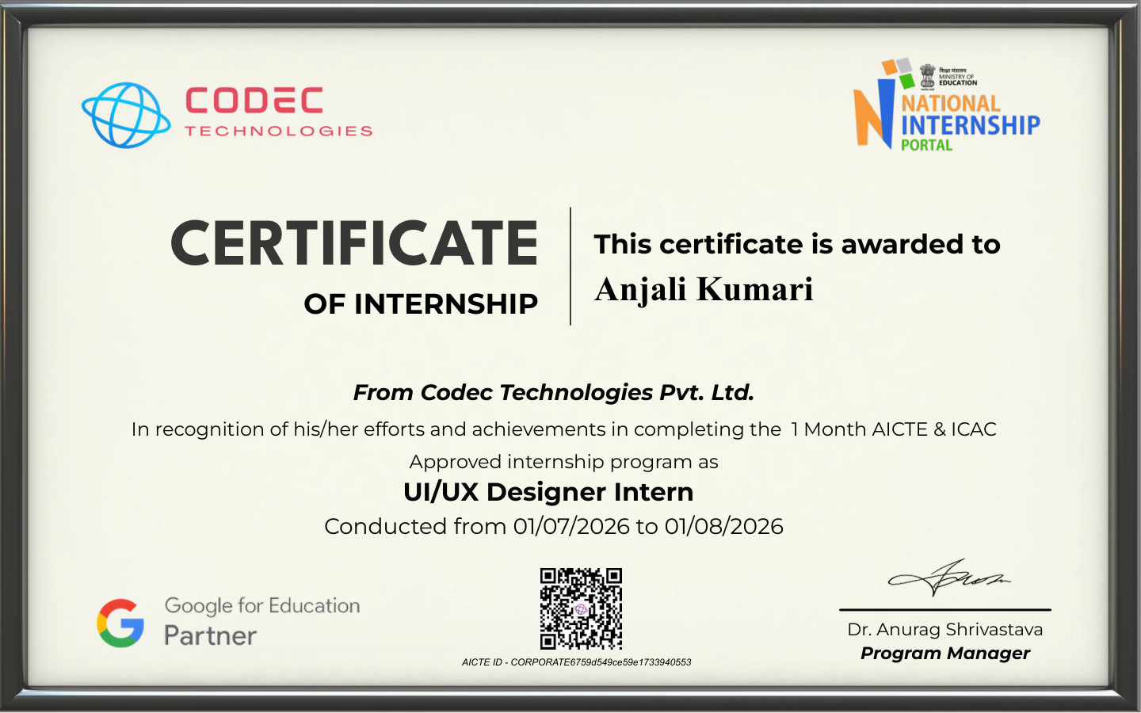
Internship Certificate

Slide 10
Conclusion
The internship was completed as a UI/UX Designer Intern at Codec Technologies Pvt. Ltd.
The certificate confirms a one-month AICTE & ICAC Approved internship conducted from 01/07/2026 to 01/08/2026.
The experience provides a foundation for applying user-centered UI/UX design principles in future academic and professional work.
Thank You

